Slide 1
Data Visualization
Programming for Data Analysis (CT127-3-2-PFDA and Version VC1)

Slide 2
Topic & Structure of the lesson
Data Visualization
Line graph
Bar chart
Histogram
Scatter plot
Box plot

Slide 3
Learning outcomes
At the end of this topic, you should be able to:
Understand how to use R’base graphics and ggplot2 package for data visualization.

Slide 4
Key terms you must be able to use
If you have mastered this topic, you should be able to use the following terms correctly in your assignments and exams:
Data visualization
ggplot2 package
Line graph
Bar chart
Histogram
Scatter plot
Box plot

Slide 5
Data Visualization
Data visualization is the graphic representation of data.
Graphics are used in statistics primarily for two reasons: exploratory data analysis (EDA) and presenting results.
The ggplot2 package is widely used to perform data visualization in R.
To install ggplot2: install.packages(“ggplot2”)
To load ggplot2: library(ggplot2)
The basic structure for ggplot2 starts with the ggplot function, which takes the data as its first argument. After that, layers can be added using the + symbol.

Slide 6
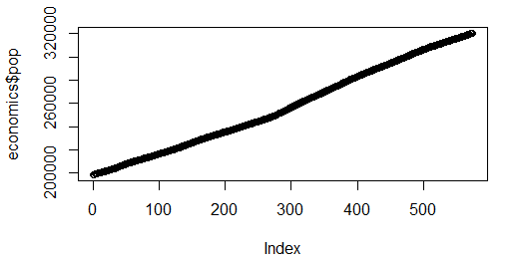
Line Graph
plot function can be used to plot line graphs.
R’s base graphics
data(economics, package=“ggplot2”)
plot(x=economics$pop)

Slide 7
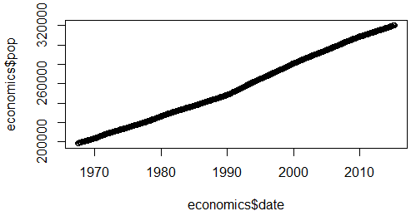
Line Graph
R’s base graphics
data(economics, package=“ggplot2”)
plot(x=economics$date, y=economics$pop)

Slide 8
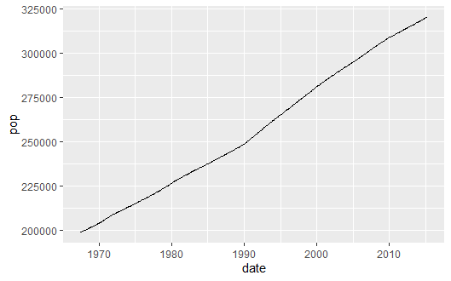
Line Graph
ggplot () with geom_line () functions in the ggplot2 package are used to plot line graphs.
geom_line () function connects the observations in order of the variable on the x axis.
ggplot(economics, aes(x=date, y=pop)) + geom_line()

Slide 9
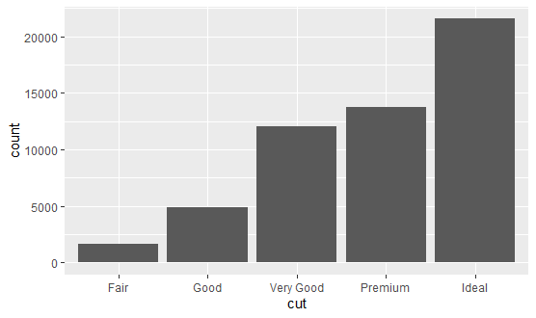
Bar chart
A bar chart shows categorical variable’s data in bars with heights proportional to that variable's values.
ggplot () with geom_bar () functions in the ggplot2 package are used to plot bar charts.
geom_bar() makes the height of the bar proportional to the number of cases in each group
ggplot(data = diamonds) + geom_bar(mapping = aes(x = cut))

Slide 10
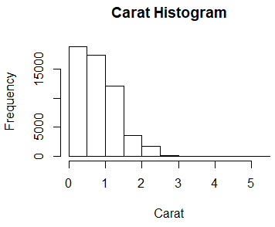
Histogram
Histogram shows the distribution of values for a variable.
Histograms break the data into buckets and the heights of the bars represent the number of observations that fall into each bucket.
The default settings for hist function is used to computes a histogram of the given data values then plot it.
R’s base graphics
data(diamonds, package=“ggplot2”)
hist(diamonds$carat, main="Carat Histogram", xlab="Carat")

Slide 11
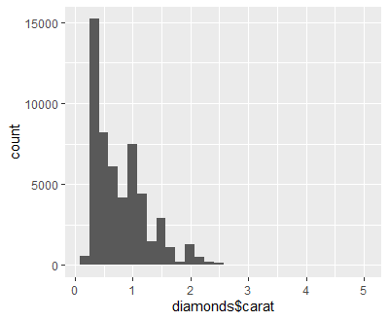
Histogram
ggplot() with geom_histogram() in the ggplot2 package are used to plot histograms.
Using ggplot2 package
ggplot(data=diamonds, aes(x=carat)) + geom_histogram()

Slide 12
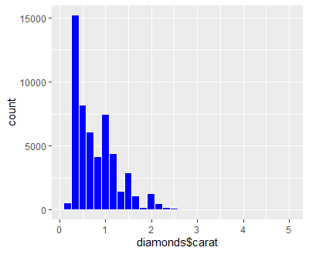
Histogram
Using ggplot2 package
ggplot(data=diamonds, aes(x=carat)) + geom_histogram(col="white", fill="blue")

Slide 13
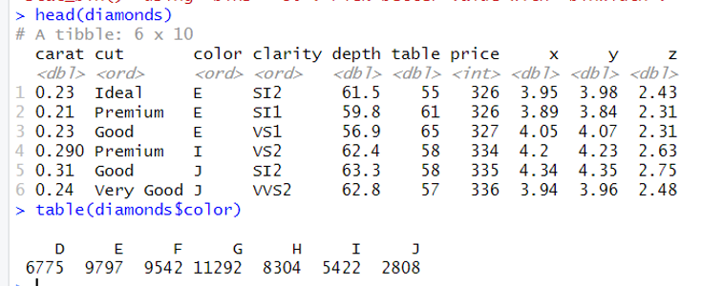
Histogram

Slide 14
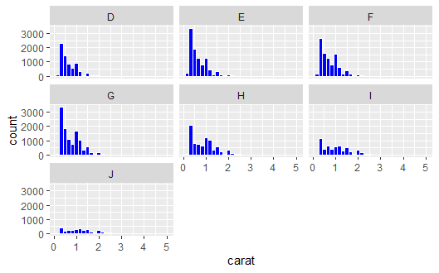
Histogram
facet_wrap() in the ggplot2 package is used to wraps a 1d sequence of panels into 2d.
ggplot(diamonds, aes(x=carat)) + geom_histogram(col="white", fill="blue") + facet_wrap(~color)

Slide 15
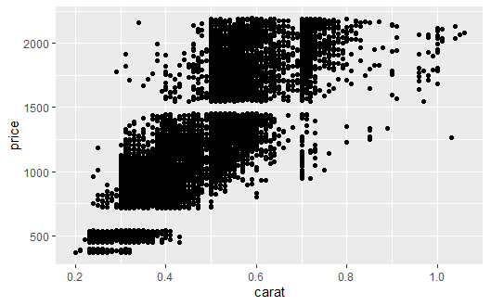
Scatterplot
Scatterplot is a diagram that is used to visualize the covariation between two continuous variables. Covariation is a correlated variation of two or more variables.
Every point represents an observation in two variables where the x-axis represents one variable and the y-axis another.

Slide 16
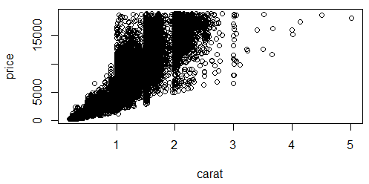
Scatterplot
plot function can be used to create scatterplots.
R’s base graphics
plot(diamonds$carat, diamonds$price)
plot(price ~ carat, data=diamonds)
The ~ separating price and carat indicates that we are viewing price against carat, where price is the y value and carat is the x value

Slide 17
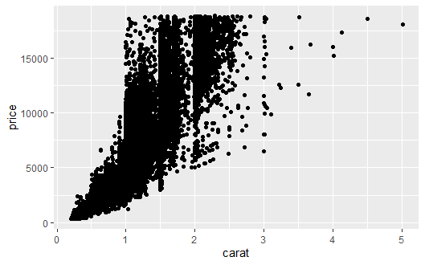
Scatterplot
ggplot() with geom_point() in the ggplot2 package are used to create scatterplots.
Using ggplot2 package
ggplot(diamonds, aes(x=carat, y=price)) + geom_point()

Slide 18
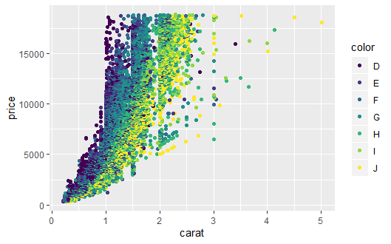
Scatterplot
Using ggplot2 package
ggplot(diamonds, aes(x=carat, y=price)) + geom_point(aes(color=color))

Slide 19
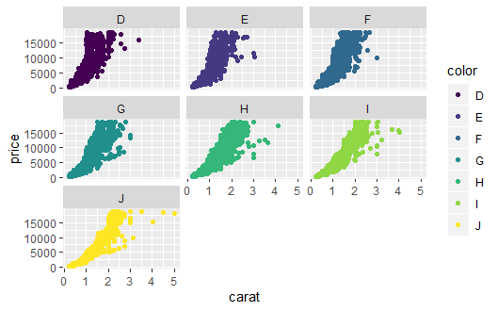
Scatterplot
ggplot(diamonds, aes(x=carat, y=price)) + geom_point(aes(color=color)) + facet_wrap(~color)
facet_wrap takes the levels of one variable, cuts up the underlying data according to them, makes a separate pane for each set and arranges them to fit in the plot.

Slide 20
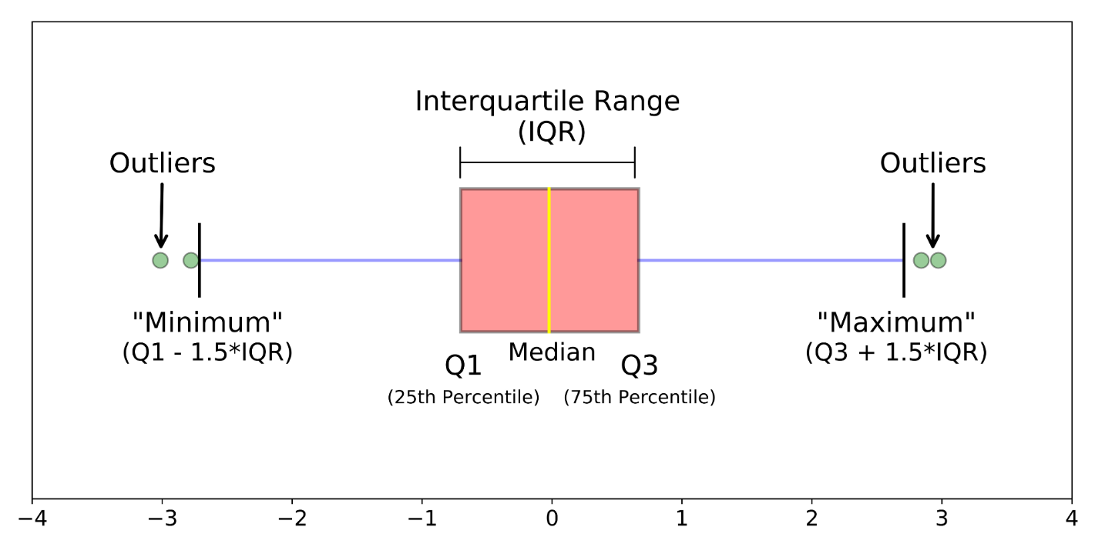
Boxplot
Boxplot depicts groups of numerical data through their quartiles.
The middle line in the boxplot represents the median and the box is bounded by the first and third quartiles.
The Interquartile Range (IQR) represents the middle 50% of data.
https://towardsdatascience.com/understanding-boxplots-5e2df7bcbd51

Slide 21
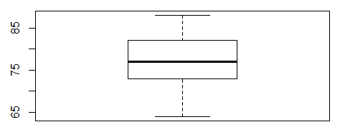
Boxplot - Example
A series of hourly temperatures were measured throughout the day in degrees Fahrenheit.
The recorded values are listed in order as follows: 64, 64, 64, 65, 70, 73, 73, 74, 74, 75, 76, 77, 77, 77, 77, 79, 80, 82, 82, 83, 83, 85, 86, 88.
> summary(temp)
Min. 1st Qu. Median Mean 3rd Qu. Max.
64.00 73.00 77.00 76.17 82.00 88.00

Slide 22
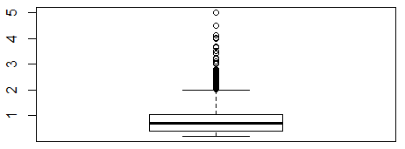
Boxplot
boxplot function is used to produce boxplots.
R’s base graphics
boxplot(diamonds$carat)

Slide 23
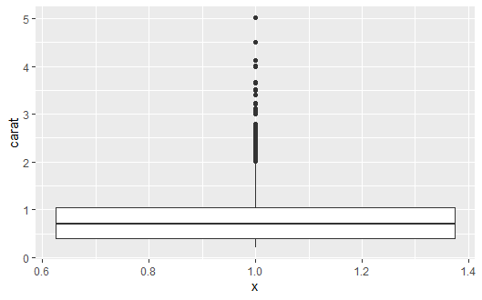
Boxplot
ggplot() with geom_boxplot() in the ggplot2 package are used to produce boxplots.
Using ggplot2 package
ggplot(diamonds,aes(y=carat, x=1)) + geom_boxplot()
Even though it is one-dimensional, using only a y aesthetic, there needs to be some x aesthetic, so we will use 1.

Slide 24
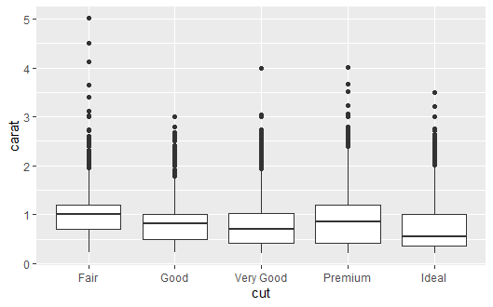
Boxplot
Using ggplot2 package
ggplot(diamonds, aes(y=carat, x=cut)) + geom_boxplot()

Slide 25
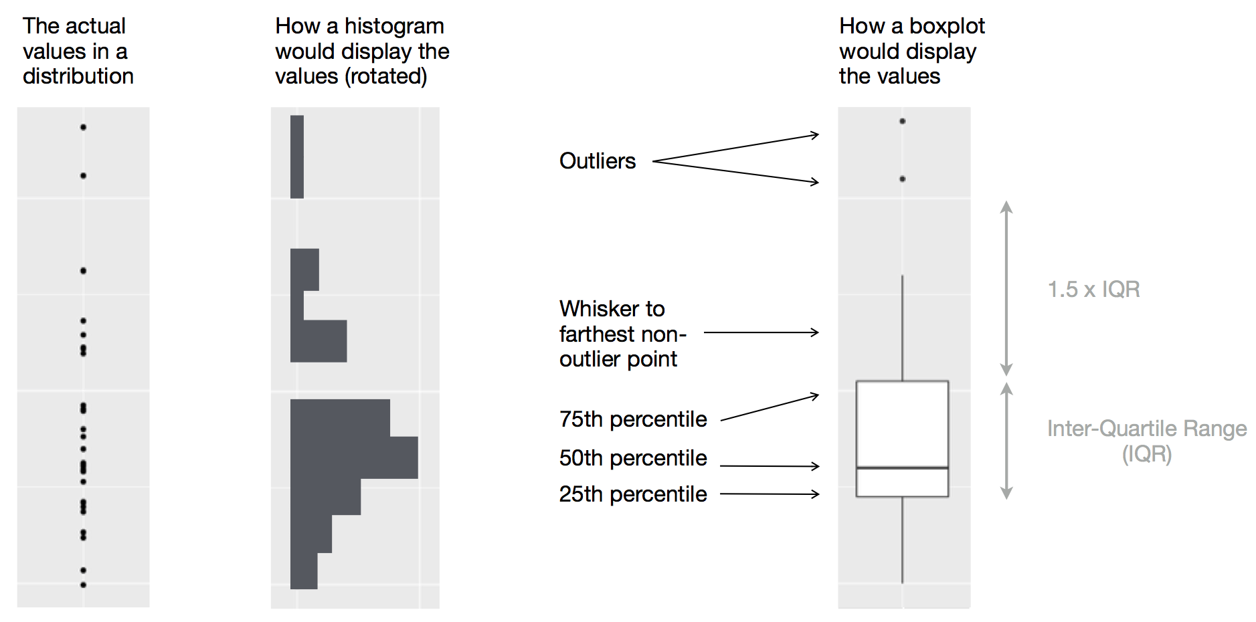
Boxplot
https://r4ds.had.co.nz/exploratory-data-analysis.html#missing-values-2

Slide 26
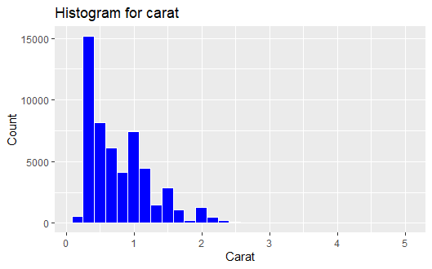
Modify axis and plot labels
ggplot(data=diamonds) + geom_histogram(aes(diamonds$carat),col="white", fill="blue")+
labs(title="Histogram for carat", x=" Carat", y="Count")

Slide 27
Quick Review Questions
How to plot a line graph in R?
What is a bar chart and how to plot it in R?
What is a histogram and how to plot it in R?
What is a scatter plot and how to plot it in R?
What is a boxplot and how to it in R?

Slide 28
Summary of Main Teaching Points
Line Graph
Bar chart
Histogram
Scatter plot
Box plot

Slide 29
Q & A

Slide 30
Next Session
Data Exploration
Missing values
Variation
Covariation

